Slide 1
Second order derivative filter

Slide 2
The principle objective of sharpening is to highlight transitions in intensity.
Applications include electronic printing ,medical imaging , industrial inspection , automatic guidance in military systems.
Image averaging analogues to integration , sharpening corresponds to differentiation
Fundamentally strength of the response of a derivative operator is proportional to the degree of intensity discontinuity of the image at the point at which the operator is applied .
Image differentiation enhances edges and other discontinuities and
deemphasizes areas with slowly varying intensities

Slide 3
Sharpening filters based on first and second order derivatives
Derivatives of a digital function are defined in terms of differences
First derivatives :
Must be zero in areas of constant intensities
Must be nonzero at the onset of an intensity step or Ramp
Must be nonzero along the ramps
Second derivatives:
Must be zero in areas of constant intensities
Must be nonzero at the onset of an intensity step or Ramp
Must be zero along the ramps

Slide 4



First order derivative of a one dimensional function f(x) given by
Second order derivative of f(x) as the difference
Using Second order derivatives for Image Sharpening –Laplacian :
Second order derivatives used in image segmentation
Simplest second order derivative operator is Laplacian , Which for the function f(x,y) of two variables is defined as

Slide 5



Second derivative in discrete form , in ‘x’ directions given by
Similarly in ‘y ‘ direction
Discrete Laplacian of ‘2’ variables is

Slide 6
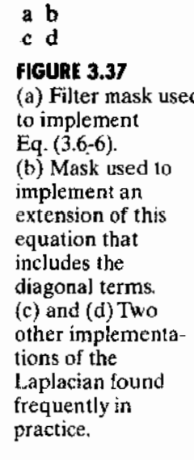
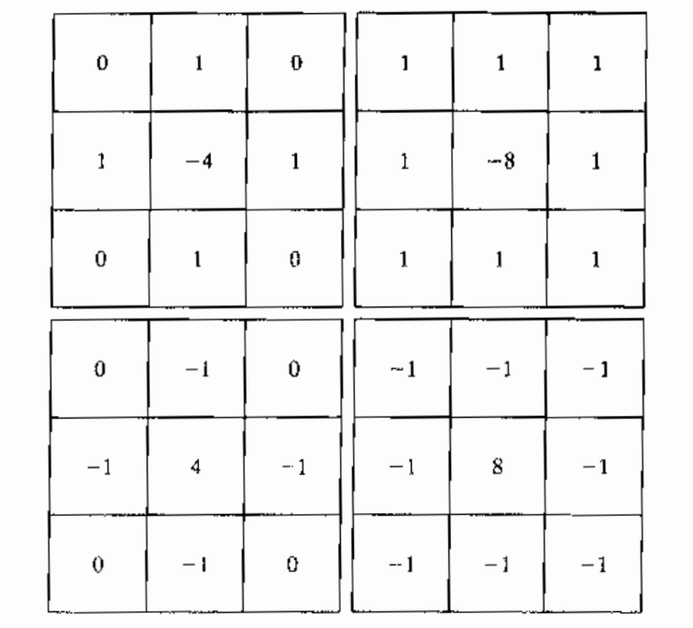
This equation can be implemented with digital filter

Slide 7

Laplacian is a derivative operator , its use highlights intensity discontinuities in an image and deemphasizes regions with slowly varying intensity values
Laplacian will produce images that have grayish edge lines and other discontinuities , all superimposed on a dark features less background
Background features can be recovered , while still preserving the sharpening effect of the Laplacian , by adding Laplacian image to the original
The constant C=-1 ,if the Laplacian filters having negative center coefficients , C=1 for other two filters

Slide 8
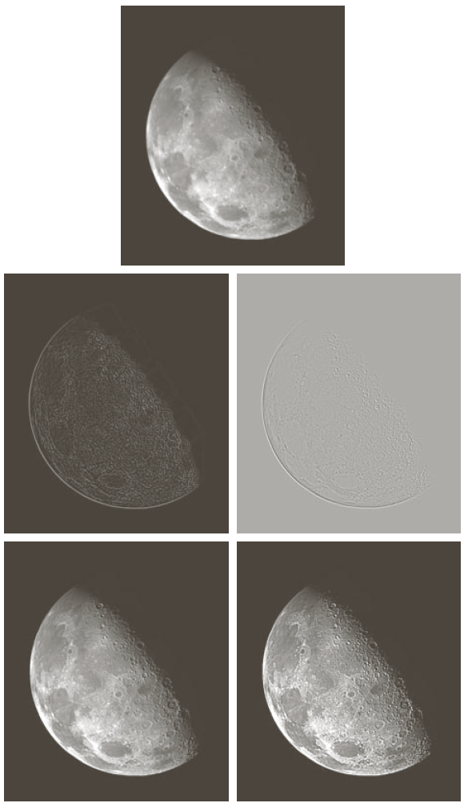

Slide 9


Given an image f , first perform
Then perform the operation
With K =255 , fs is a scaled image
After applying filters , Fig 3.37 d and e are much clear than original image

Slide 10
Edges in digital images often are ramp like transitions in intensity , the first derivative of the image would result in thick edges because the derivative is nonzero along a ramp
Second derivatives produce a double edge of one pixel thick separated by zeros ,
so second derivative enhance the fine details much better than first order filter

Slide 11
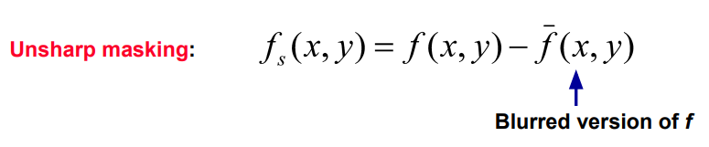


Unsharp masking and high-boost filtering
A process used to sharpen images consists of subtracting a blurred image from the image itself , this process called unsharp masking
Is sharpened image
A high boost filtered image is defined at any point x,y as

Slide 12



Where A>= 1 ,
is a blurred version of f(x,y)
= (A-1)f(x,y)+
above Equation is applicable in general and does not state explicitly how the sharp image is obtained
is sharpened image , which is our g(x,y)
= Af(x,y)-
If the center coefficient of the Laplacian mask is negative
=Af(x,y)+
If the center coefficient of the Laplacian mask is positive

Slide 13
High boost filtering can be implemented with one pass using either of the two masks shown in fig 3.42
When A=0 it is equivalent applying standard Laplacian mask
With A=1 , it is equivalent to sharpened image
With A>1 , is high boost filtering result where gray levels will be increased

Slide 14
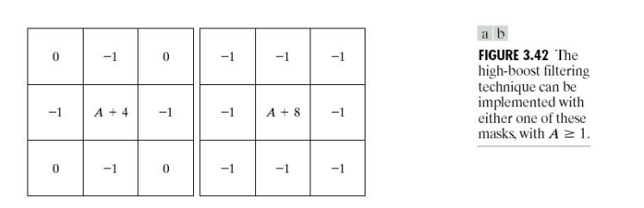

Slide 15
